Slide 1
HR Company Case Study Presentation
15/11/2023
Luis Lorman

Slide 2
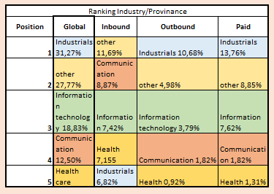
Key Targets
% Grant total Sum
Provenance: 1°Inbound vs Outbound & Paid
Sectors: industrial, other, information technology, communication, HealthCare. ¾ sum & n°
Profile size: avg 30 employees. Industrial avg 40
95% Companies < 100 employees & 88.5% “sum” - Corr. 0.92
Timing: Q1 vs Q3/Q4
To whom? CEOs, HR Directos. Via Linkedln and Demo.
Why us? 78%. Time-related matters.
12% coming from Personio
N° Accounts
Other: 66
Industrial: 43
Information: 42
Health: 22
Communication: 19

Slide 3
Top 10
Sum Vs Number
Row Labels | Total Count
Other | 66
Industrials | 43
Information technology | 42
Health care | 22
Communication | 19
Real estate | 13
Finance | 8
Legal services | 8
Energy | 7
Entertainment | 7
Grand Total | 235
Company age? N°workers/ age?

Slide 4
Performance

Slide 5
First Quarters impresion / % Sum
Attention to the month split

Slide 6

Monthly Opening/Closing Amount
Q1&Q2
Fewer companies but higher avg value due to company size. Mrz. avg 49 – Outlayers?
Q3&Q4: biggest n°and value
More value, more companies, but smaller.
Conclusión – balanced but…
Q1 and Q3/4 are key. Start targeting companies before next year.
Ticket time resolution
Total avg: 29 days - from 12 to 49.
June: record avg 49 days

Slide 7
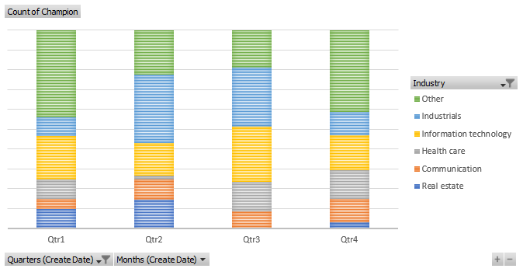
Quarter/Industry
Crr(global): -0,11
Crr (month): -0,09
Target all industries regardless of Q
Industrial has more activity in Q2&3 vs Global trend.
However lineal correlation (industry/time) not that ensured.

Slide 8
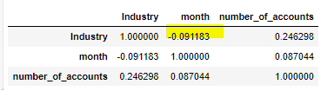
(n°acco. not value, group by industry)
Crr(global): -0,11
Crr (month): -0,09
Month vs Industry
“Other“ follows the global trend, in June less activity vs Real State.
23% Real State accounts are in June
Note: Real State top month in June (opposite than global tendency), but only 13 accounts within 1 year.
Not enough data (year) and patterns to ensure a 100% industry/time prediction.

Slide 9

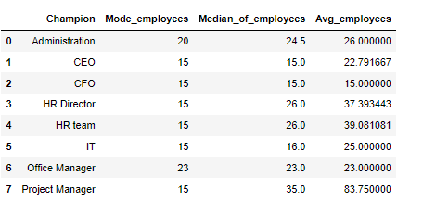
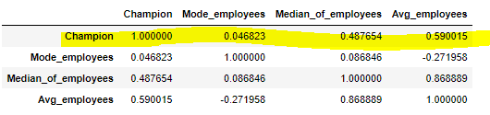
Champion vs Decision Maker
To maximize results, it's advisable to target CEOs, HR Directors, and HR teams in Q1 and during Q3/Q4, since basically 4/5 of earnings and accounts are generated during this time period.
Furthermore, 56% of earnings in the outbound category originate from LinkedIn.
Inbound demos also prove extremely successful, contributing to 22.9% of overall earnings, making it the highest-performing method within the paid category.
No correlation size / Decisión maker. CrrGl: 0,13
Smaller size = Champion -> +% CEO CrrGl: 0.32
Note, this 9% is a combination of both outbound and inbound decisions.

Slide 10

Time-related issues are the main point of hiring this software/service 78%. Good point regarding to easiness of use and ATS. Interesting Apps…
12% of all accounts come from competitors (almost all from Personio). Why? the manual work.
I suggest keeping an eye on this competitor and developing a friendlier product for user management, as this seems to be the key decision for customer acquisition along with the previously mentioned ones…
Why us?

Slide 11
Customer process
Stakeholders
Client
Sales Team
Finance team /Bank
Customer Success Team (Account Manager 1° for 0-100 employees & Account Manager 2° from 100.
France, Spain, Brazil
Step 1
Sales team & client
This stage is crucial in the process as it ensures the entire operation's success. It's imperative that the company is thoroughly prepared for the onboarding process.Desde el principio.
Step 2
Financial Team
Step 3
Customer Success Team
The Finance Team ensures that at least a portion of the payment is received
100% verified before proceeding.
In case of any uncertainty, the finance team must follow up and verify.
Onboarding and customer satisfaction.
Client retantion

Slide 12
Step 1
Sales team & client
Title: Contractual Agreement and Onboarding Preparation
Key Points:
Importance of Preparation for Onboarding
Elements of the Contract (Onboarding timeline, data protection and policy, software usage, payment terms)
Considerations for Transactions in Brazil
Checklist for Sales Team (Payment methods, timelines, devices, data protection, onboarding after payment etc.)
Importance of Accurate Contracts for Customer Satisfaction- Win-Win relationship

Slide 13
Step 2
Financial Team
Title: Finance Team's Role in Payment Processing
Key Points:
Transition from Sales to Finance
Essential Information in Tickets for Invoicing
Importance of Bank and Payment Verifications – Payment within 30 days, discount in rapid payments.
Ensuring Payment in Bank Account Before Onboarding. All or part according to the business.
Ticket Closure and Sales Team Notification – 30 days.

Slide 14
Step 3
Customer Success Team
Title: Tailoring Customer Experience and Handling Post-Onboarding
Key Points:
Account Tiers based on Company Details
Linking Tickets to Maintain Client Interaction Record
Requests for Service Upgrades or Cancellations alongside Sales Pipeline
Tech tickets and timezone Brazil vs European Team.
Incorporating Reasons for Cancellation in Ticketing System -
Win-Win relationship

Slide 15
Ticket System Summary
Title: Structuring and Managing Tickets
Key Points:
Categorization based on Company Details and Contract Agreements
Features: Attachments, Internal Chat, and Documentation – Documentation by ticket team and not all attached together.
Ticket Workflow Stages – key words
Periodic Follow-ups for Client Awareness and Satisfaction

Slide 16
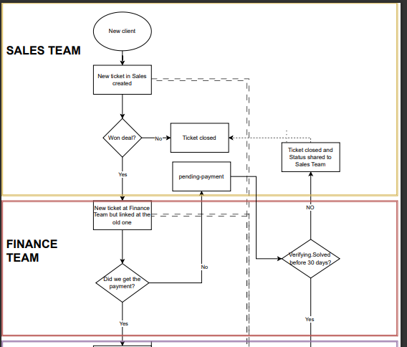

Slide 17
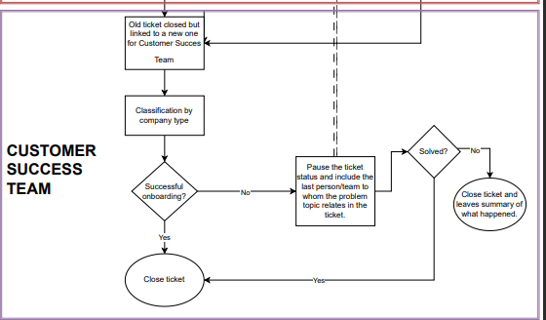

Slide 18
Thank you

